Slide 1
Third pass analysis
Human samples:
Control: K70 (3 samples)
P10-treated: K70P10 (2 samples, sample#3 removed)
MD-treated: K70MD (3 samples)
Purpose:
To validate P10 and MD as inhibitors of the NRF2 pathway in human ESCC cells
To find additional pathways affected by P10 and/or MD for future studies

Slide 2
Analyses
Generate a DEG list (DEG1) by comparing K70 vs K70P10 (p<0.01; log2FC>1 or <-1)
Generate a DEG list (DEG2) by comparing K70 vs K70MD (p<0.01; log2FC>1 or <-1)
Use David’s gene list as DEG3 (229 positive and 5 negative). Note: Positive genes are upregulated in NRF2^{high} ESCC as compared with NRF2^{low} ESCC, and negative genes are downregulated. Therefore these 234 genes may be designated as “NRF2-responsive genes in human ESCC”.
PCA of K70 (3 samples), K70MD (3 samples), and K70P10 (2 samples) to show distinct clustering
VENN diagram
DEG1 and DEG2: 理论上DEG2应该包括>=50% DEG1
DEG1 and DEG3: 说明P10处理细胞后，那些变化的基因中有多少受NRF2调控？
DEG2 and DEG3: 说明MD处理细胞后，那些变化的基因中有多少受NRF2调控？
DEG1, DEG2 and DEG3：说明P10或MD处理细胞后，那些共同变化的基因中有多少受NRF2调控？

Slide 3
Analyses -- continued
Heatmap
用DEG3（234个基因）做K70，K70P10，K70MD，共8个标本
用DEG1/DEG2/DEG3 overlap的基因，做K70，K70P10，K70MD，共8个标本
Pathway analysis
DEG1做pathway analysis证明, P10 treatment downregulates NRF2 pathway and downregulates/upregulates some other pathways
DEG2做pathway analysis，证明MD treatment downregulates NRF2 pathway and downregulates/upregulates some other pathways
DEG3做pathway analysis，佐证这个list确实是NRF2 pathway（当然会包括一些其它通路，而且所谓NRF2 pathway是一大类，在数据库里会显示为很多不同名字的通路，比如redox regulation, response to oxidative stress, drug metabolism, …）

Slide 4
Mouse samples
Samples
SH (3 samples)
AG (3 samples)
Objectives
to find differentially expressed genes and pathways due to AG treatment in mouse cells
Analysis
PCA: to show SH samples and AG samples cluster in two distinct groups. If not, some samples may be eliminated in the following analyses.
DEG4 (p<0.01, log2FC>1 or <-1)
Heatmap using DEG4
Pathway analysis: to find what pathways may be upregulated/downregulated by AG treatment.

Slide 5
Analysis update
STAR → DEseq2
Salmon → quantitative method?

Slide 6
Finalize DESeq2 protocol

Slide 7
DEG list 2
2550 DEGs
447 DEGs
2016 DEGs
1727 DEGs

Slide 8
DEG list 1
421 DEGs
258 DEGs

Slide 9
DEG list 1
1990 DEGs

Slide 13
83 DEGs
40 DEGs
661 DEGs
484 DEGs

Slide 14
102 DEGs
220 DEGs
63 DEGs
125 DEGs

Slide 15
K70_vs_K70MD_pvalue01_fc4 - DEGs (2016)

Slide 16
K70_vs_P10_pvalue05_fc4 - DEGs (421)
Notes:
P10_3 could be an outlier!!

Slide 17
K70_vs_NKO70_pvalue05_fc2 - DEGs (661)
Notes:
NKO have most down-regulated genes
P70_1_2: have up-regulated genes, P70_3 are more like MD

Slide 18
DDIT4,GJB4, IL21R ,MAP3K7CL, MOBP, ODAPH ,RAET1L, RFX8, SPINK2, SPINK6, SYTL2, ZBED2
LINC01204, LINC02321
LOC101929128, LOC102546229, LOC105379051

Slide 19
DEGs were selected at
adjusted p-value < 0.01
and FC > 2

Slide 20
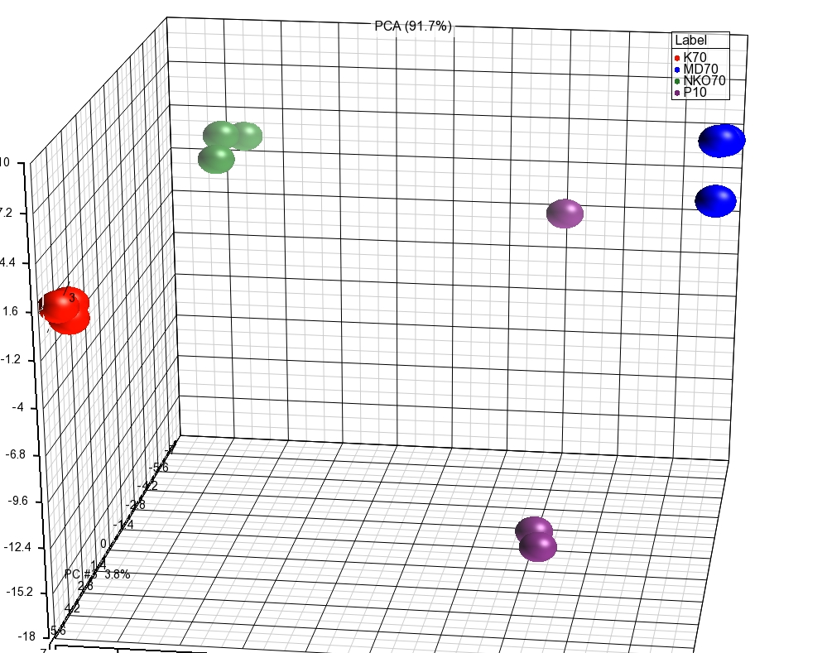
Common DEGs (K70MD & K70P10) – 593 genes

Slide 21
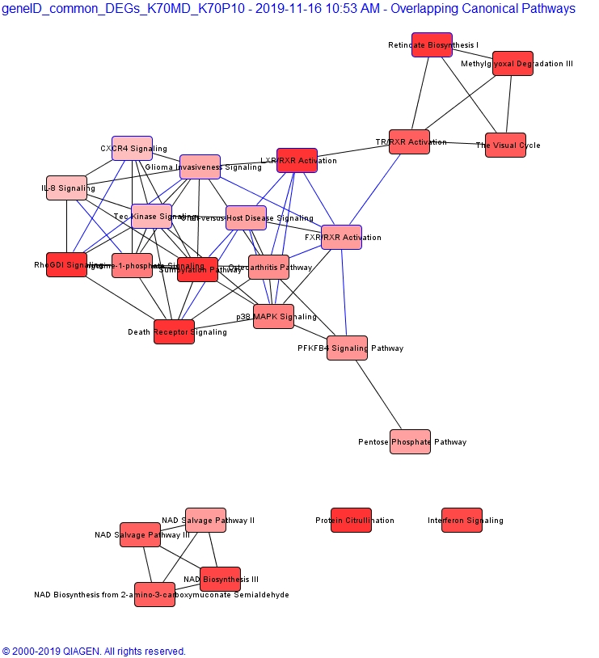

Slide 22
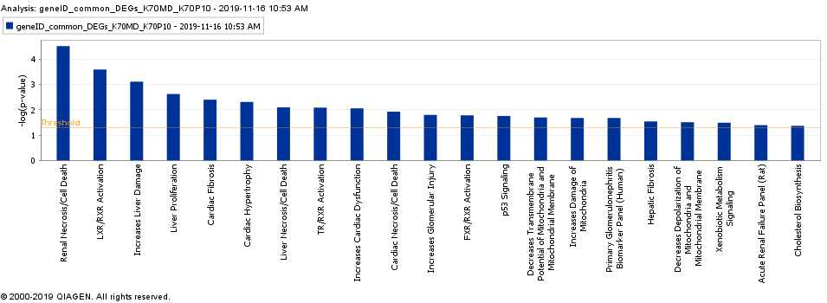

Slide 23
DEGs were selected at
adjusted p-value < 0.01
and FC > 2
DEGs were selected at
adjusted p-value < 0.01
and FC > 4

Slide 24
DEGs for K70MD were selected at
adjusted p-value < 0.01, and FC > 4
DEGs for P10 were selected at
adjusted p-value < 0.01, and FC > 2
DEGs were selected at
adjusted p-value < 0.01
and FC > 4
Notes:
None of 196 overlap with PAM50!!

Slide 25
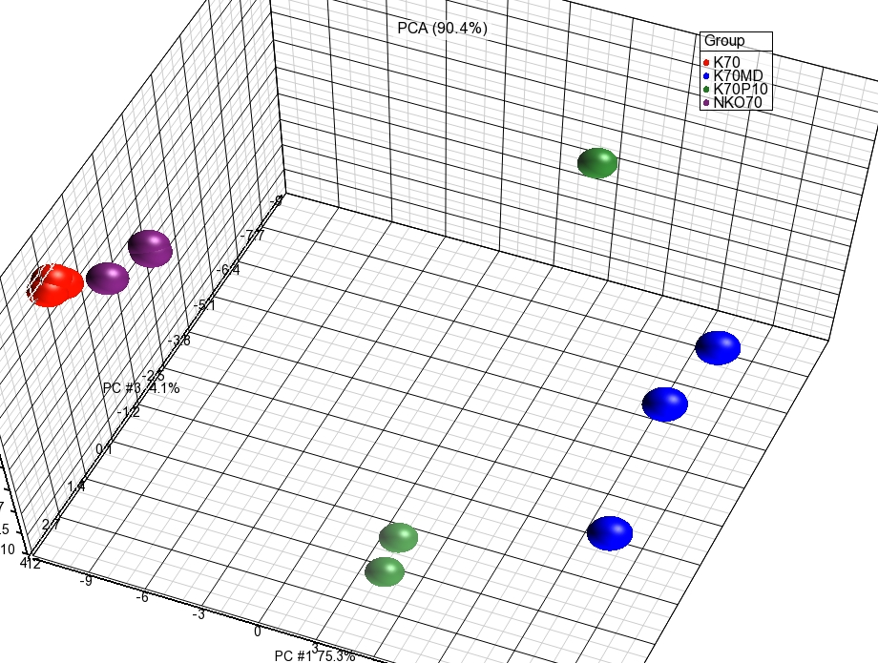
ESCC_196_signatures

Slide 26
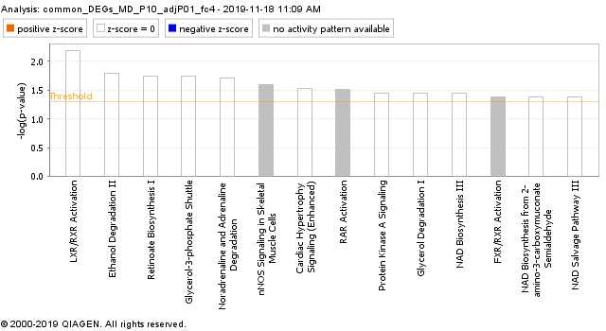
ESCC_196_signatures

Slide 27
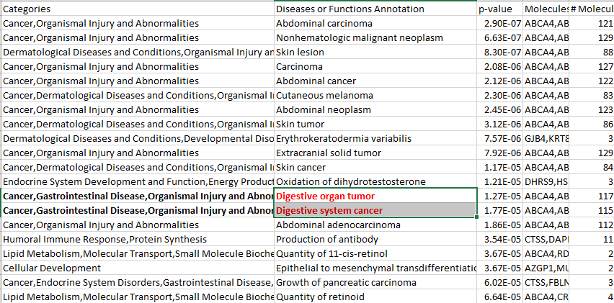
IPA – disease related results (ESCC_196_signatures)

Slide 28
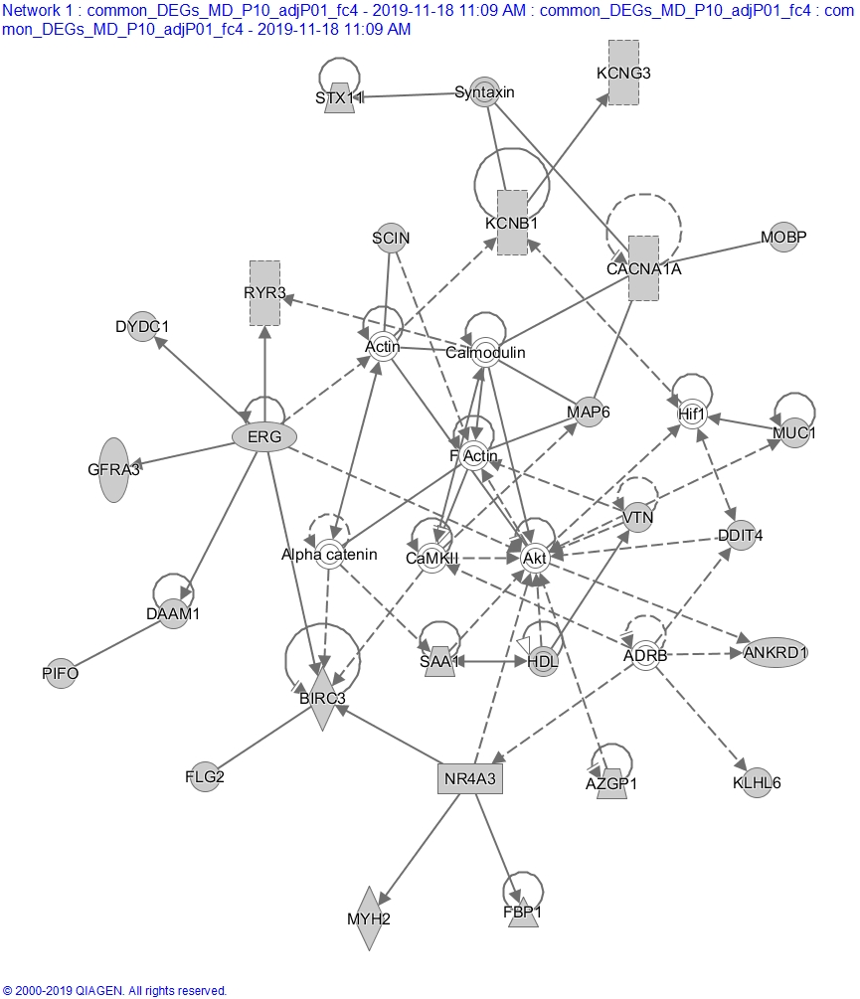

Slide 29
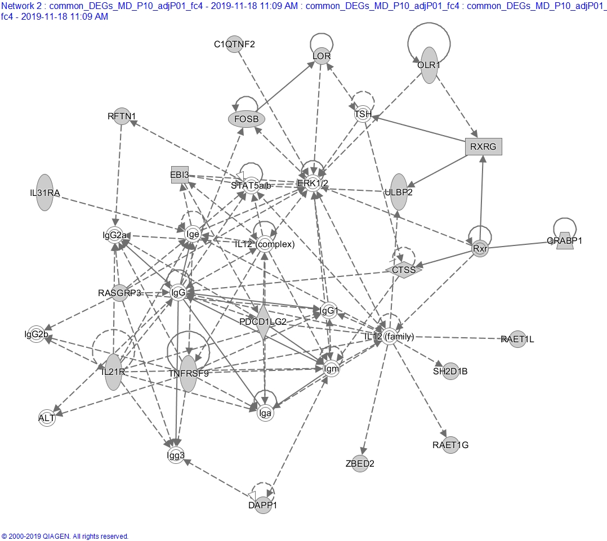

Slide 30
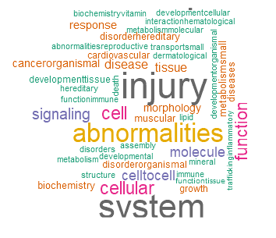
ESCC_196 signature -- disease cloud
https://2waybene.shinyapps.io/miRNATag/

Slide 31
Supporting slides

